Slide 1
Lecture 13
Signals and Systems (ELL205)
By Dr. Abhishek Dixit
Dept. of Electrical Engineering
IIT Delhi

Slide 2
Towards Fourier Series
Love of Sinusoid

Slide 3
Outline of the lecture
Why sinusoids?
How an LTI system react to sinusoids?
How do we break signal as sums of sinusoids?

Slide 4
Outline of the lecture
Why sinusoids?
  Psychoacoustics
  Images
  Signal generation
How an LTI system react to sinusoids?
How do we break signal as sums of sinusoids?

Slide 5
Outline of the lecture
Why sinusoids?
  Psychoacoustics
  Images
  Signal generation
How an LTI system react to sinusoids?
How do we break signal as sums of sinusoids?

Slide 6
Psychoacoustics
Study of how human ear hears

Slide 7
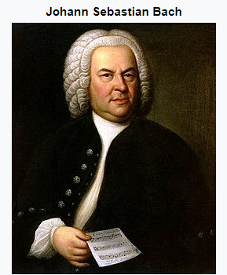



Western Music
A | 880
G# | 831
G | 784
F♯ | 740
F | 698
E | 659
D♯ | 622
D | 587
C♯ | 554
C | 523
B | 494
A# | 466
A | 440
440 to 880 octave (musical term for factor two)
There are twelve notes in one octave
$$494×\sqrt[12]{2}$$
$$466×\sqrt[12]{2}$$
J. S. Bach, 1685-1750
$$440×\sqrt[12]{2}$$

Slide 8

Western Music
A | 880
G# | 831
G | 784
F♯ | 740
F | 698
E | 659
D♯ | 622
D | 587
C♯ | 554
C | 523
B | 494
A# | 466
A | 440
440 to 880 octave (musical term for factor two)
There are twelve notes in one octave
$$494×\sqrt[12]{2}$$
$$466×\sqrt[12]{2}$$
J. S. Bach, 1685-1750
$$440×\sqrt[12]{2}$$

Slide 9
Western Music
A | 880
G# | 831
G | 784
F♯ | 740
F | 698
E | 659
D♯ | 622
D | 587
C♯ | 554
C | 523
B | 494
A# | 466
A | 440
440 to 880 octave (musical term for factor two)
There are twelve notes in one octave
$$494×\sqrt[12]{2}$$
$$466×\sqrt[12]{2}$$
J. S. Bach, 1685-1750
$$440×\sqrt[12]{2}$$

Slide 10
Western Music
A | 880
G# | 831
G | 784
F♯ | 740
F | 698
E | 659
D♯ | 622
D | 587
C♯ | 554
C | 523
B | 494
A# | 466
A | 440
440 to 880 octave (musical term for factor two)
There are twelve notes in one octave
$$494×\sqrt[12]{2}$$
$$466×\sqrt[12]{2}$$
J. S. Bach, 1685-1750
$$440×\sqrt[12]{2}$$

Slide 11
Western Music
A | 880
G# | 831
G | 784
F♯ | 740
F | 698
E | 659
D♯ | 622
D | 587
C♯ | 554
C | 523
B | 494
A# | 466
A | 440
440 to 880 octave (musical term for factor two)
There are twelve notes in one octave
$$494×\sqrt[12]{2}$$
$$466×\sqrt[12]{2}$$
J. S. Bach, 1685-1750
$$440×\sqrt[12]{2}$$

Slide 12
Western Music
A | 880
G# | 831
G | 784
F♯ | 740
F | 698
E | 659
D♯ | 622
D | 587
C♯ | 554
C | 523
B | 494
A# | 466
A | 440
440 to 880 octave (musical term for factor two)
There are twelve notes in one octave
$$494×\sqrt[12]{2}$$
$$466×\sqrt[12]{2}$$
J. S. Bach, 1685-1750
$$440×\sqrt[12]{2}$$

Slide 13
Western Music
A | 880
G# | 831
G | 784
F♯ | 740
F | 698
E | 659
D♯ | 622
D | 587
C♯ | 554
C | 523
B | 494
A# | 466
A | 440
440 to 880 octave (musical term for factor two)
There are twelve notes in one octave
$$494×\sqrt[12]{2}$$
$$466×\sqrt[12]{2}$$
J. S. Bach, 1685-1750
$$440×\sqrt[12]{2}$$

Slide 14
Western Music
A | 880
G# | 831
G | 784
F♯ | 740
F | 698
E | 659
D♯ | 622
D | 587
C♯ | 554
C | 523
B | 494
A# | 466
A | 440
440 to 880 octave (musical term for factor two)
There are twelve notes in one octave
$$494×\sqrt[12]{2}$$
$$466×\sqrt[12]{2}$$
J. S. Bach, 1685-1750
$$440×\sqrt[12]{2}$$

Slide 15
Western Music
A | 880
G# | 831
G | 784
F♯ | 740
F | 698
E | 659
D♯ | 622
D | 587
C♯ | 554
C | 523
B | 494
A# | 466
A | 440
440 to 880 octave (musical term for factor two)
There are twelve notes in one octave
$$494×\sqrt[12]{2}$$
$$466×\sqrt[12]{2}$$
J. S. Bach, 1685-1750
$$440×\sqrt[12]{2}$$

Slide 16
Western Music
A | 880
G# | 831
G | 784
F♯ | 740
F | 698
E | 659
D♯ | 622
D | 587
C♯ | 554
C | 523
B | 494
A# | 466
A | 440
440 to 880 octave (musical term for factor two)
There are twelve notes in one octave
$$494×\sqrt[12]{2}$$
$$466×\sqrt[12]{2}$$
J. S. Bach, 1685-1750
$$440×\sqrt[12]{2}$$

Slide 17
Western Music
A | 880
G# | 831
G | 784
F♯ | 740
F | 698
E | 659
D♯ | 622
D | 587
C♯ | 554
C | 523
B | 494
A# | 466
A | 440
440 to 880 octave (musical term for factor two)
There are twelve notes in one octave
$$494×\sqrt[12]{2}$$
$$466×\sqrt[12]{2}$$
J. S. Bach, 1685-1750
$$440×\sqrt[12]{2}$$

Slide 18
Western Music
A | 880
G# | 831
G | 784
F♯ | 740
F | 698
E | 659
D♯ | 622
D | 587
C♯ | 554
C | 523
B | 494
A# | 466
A | 440
440 to 880 octave (musical term for factor two)
There are twelve notes in one octave
$$494×\sqrt[12]{2}$$
$$466×\sqrt[12]{2}$$
J. S. Bach, 1685-1750
$$440×\sqrt[12]{2}$$

Slide 19
Western Music
A | 880
G# | 831
G | 784
F♯ | 740
F | 698
E | 659
D♯ | 622
D | 587
C♯ | 554
C | 523
B | 494
A# | 466
A | 440
440 to 880 octave (musical term for factor two)
There are twelve notes in one octave
$$494×\sqrt[12]{2}$$
$$466×\sqrt[12]{2}$$
J. S. Bach, 1685-1750
$$440×\sqrt[12]{2}$$

Slide 20
Combination of Tones to Music
song = {'A' 'A' 'E' 'E' 'F#' 'F#' 'E' 'E' 'D' 'D' 'C#' 'C#' 'B' 'B' 'A' 'A'};

Slide 21
Combination of Tones to Music
song = {'A' 'A' 'E' 'E' 'F#' 'F#' 'E' 'E' 'D' 'D' 'C#' 'C#' 'B' 'B' 'A' 'A'};

Slide 22
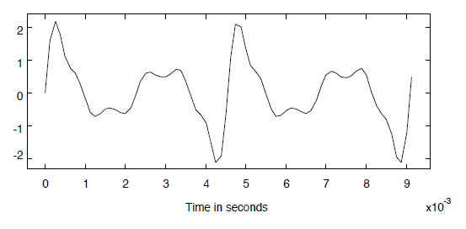
Timbre
Note A: 220 Hz, ω = 1382 rad/sec
$x\left(t\right)=\sin\left(1382t\right)+r1sin⁡(2×1382t$)+r₂$\sin\left(3×1382t\right)$+……..

Slide 23
Timbre
Note A: 220 Hz, ω = 1382 rad/sec
$x\left(t\right)=\sin\left(1382t\right)+r1sin⁡(2×1382t$)+r₂$\sin\left(3×1382t\right)$+……..

Slide 24

Timbre
Note A: 220 Hz, ω = 1382 rad/sec
$$x\left(t\right)=\sin\left(1382t\right)$$

Slide 25
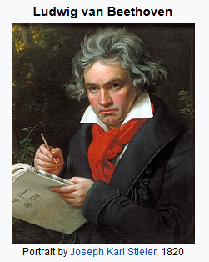
Ludwig van Beethoven
17 December 1770 – 26 March 1826
(56 years)
German composer and a pianist
His best-known compositions include
9 symphonies, 5 piano concertos,
1 violin concerto, 32 piano sonatas, 16 string quartets, his great Mass the Missa solemnis, and one opera, Fidelio.
He was deaf !!

Slide 26
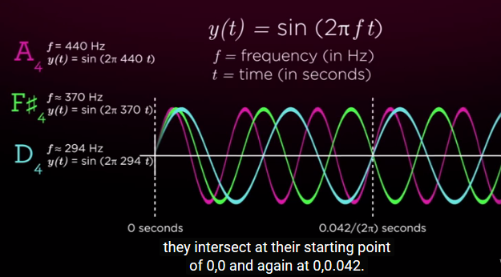
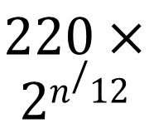
Beethoven (moonlight sonata)
$$220×$$
$$2n/12$$

Slide 27
Moonlight Sonata
Moonlight Sonata
Arbitary Sonata

Slide 28
Moonlight Sonata
Moonlight Sonata
Arbitary Sonata

Slide 29
Outline of the lecture
Applications
  Psychoacoustics
  Images
  Signal generation

Slide 30


Spatial frequencies

Slide 31
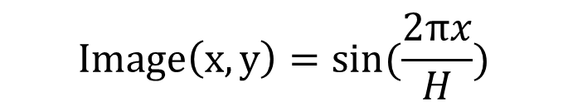
Spatial frequencies
$$Image\left(x,y\right)=sin⁡(\frac{2πx}{H})$$

Slide 32
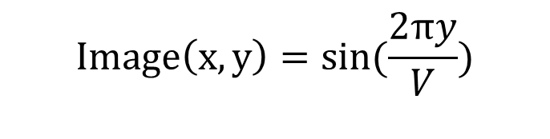
Spatial frequencies
$$Image\left(x,y\right)=sin⁡(\frac{2πx}{H})$$
$$Image\left(x,y\right)=sin⁡(\frac{2πy}{V})$$

Slide 33
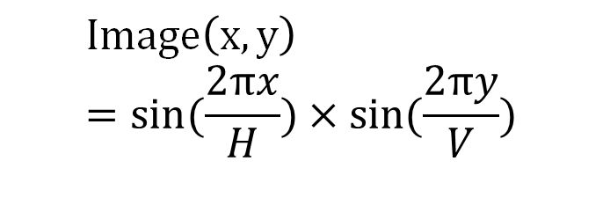
Spatial frequencies
$$Image\left(x,y\right)=sin⁡(\frac{2πx}{H})$$
$$Image\left(x,y\right)=sin⁡(\frac{2πy}{V})$$
$$Image\left(x,y\right)=sin⁡(\frac{2πx}{H})×sin⁡(\frac{2πy}{V})$$

Slide 34
Outline of the lecture
Applications
  Psychoacoustics
  Images
  Signal generation

Slide 35
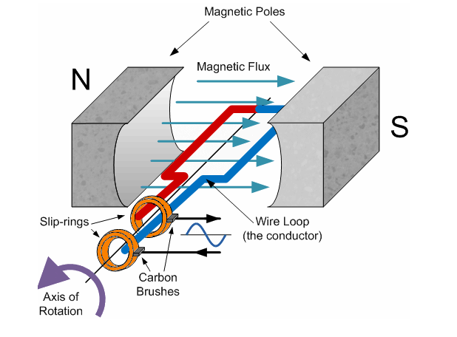
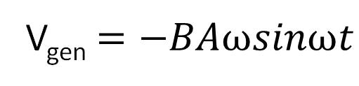
Sinusoidal source generator
V_{gen} $=−BAωsinωt$

Slide 36
Outline of the lecture
Why sinusoids?
How an LTI system react to sinusoids?
How do we break signal as sums of sinusoids?

Slide 37

Output of an LTI system to Complex Exponentials
LTI
(h(t):Real & Stable}
$$e^{j(ωt+θ)}$$

Slide 38
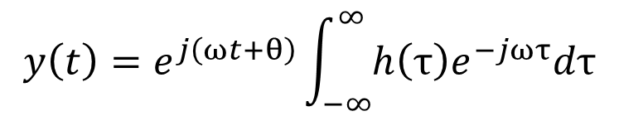
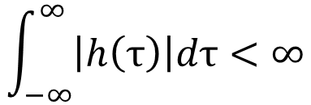
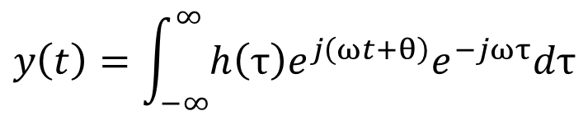
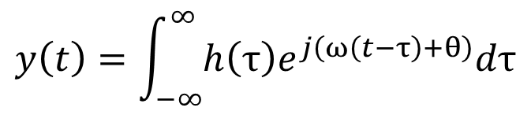
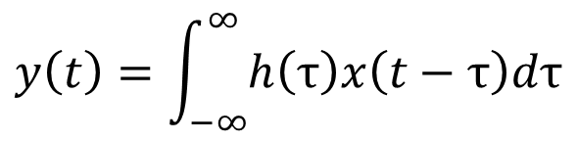
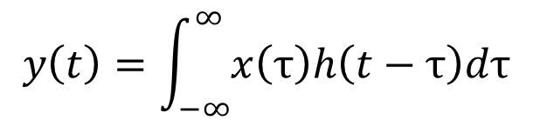
Output of an LTI system to Complex Exponentials
$$y\left(t\right)=\int_{−∞}^{∞}{x\left(τ\right)h\left(t−τ\right)dτ}$$
LTI
(h(t):Real & Stable}
$$y\left(t\right)=\int_{−∞}^{∞}{h\left(τ\right)x\left(t−τ\right)dτ}$$
$$e^{j(ωt+θ)}$$
$$y\left(t\right)=\int_{−∞}^{∞}{h\left(τ\right)e^{j\left(ω\left(t−τ\right)+θ\right)}dτ}$$
$$\int_{−∞}^{∞}{\left|h\left(τ\right)\right|dτ<∞}$$
$$y\left(t\right)=\int_{−∞}^{∞}{h\left(τ\right)e^{j\left(ωt+θ\right)}e^{−jωτ}dτ}$$
$$y\left(t\right)=e^{j\left(ωt+θ\right)}\int_{−∞}^{∞}{h\left(τ\right)e^{−jωτ}dτ}$$

Slide 39

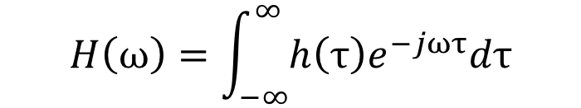
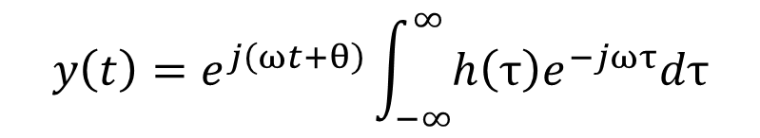
Output of an LTI system to Complex Exponentials
$$y\left(t\right)=e^{j\left(ωt+θ\right)}\int_{−∞}^{∞}{h\left(τ\right)e^{−jωτ}dτ}$$
LTI
(h(t):Real & Stable}
$$e^{j(ωt+θ)}$$
$$H\left(ω\right)=\int_{−∞}^{∞}{h\left(τ\right)e^{−jωτ}dτ}$$
$$\int_{−∞}^{∞}{\left|h\left(τ\right)\right|dτ<∞}$$
$$y\left(t\right)=e^{j\left(ωt+θ\right)}H(ω)$$
Eigen function
Eigen value

Slide 40

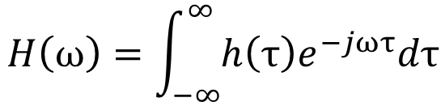
Output of an LTI system to Complex Exponentials
LTI
(h(t):Real & Stable}
$$e^{j(ωt+θ)}$$
$$y\left(t\right)=e^{j\left(ωt+θ\right)}H(ω)$$
$$H\left(ω\right)=\int_{−∞}^{∞}{h\left(τ\right)e^{−jωτ}dτ}$$
$$\int_{−∞}^{∞}{\left|h\left(τ\right)\right|dτ<∞}$$
Frequency response

Slide 41


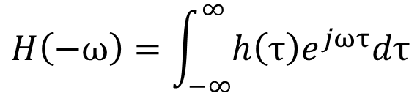
Output of an LTI system to Complex Exponentials
LTI
(h(t):Real & Stable}
$$e^{−j(ωt+θ)}$$
$$y\left(t\right)=e^{−j\left(ωt+θ\right)}H(−ω)$$
$$H\left(−ω\right)=\int_{−∞}^{∞}{h\left(τ\right)e^{jωτ}dτ}$$
$$\int_{−∞}^{∞}{\left|h\left(τ\right)\right|dτ<∞}$$
Frequency response

Slide 42

Output of an LTI system to Complex Exponentials
LTI
(h(t):Real & Stable}
$$cos(ωt)$$
$$\int_{−∞}^{∞}{\left|h\left(τ\right)\right|dτ<∞}$$

Slide 43

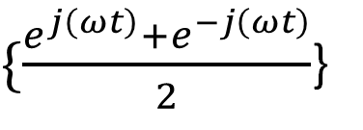
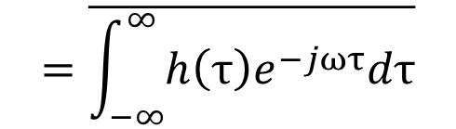
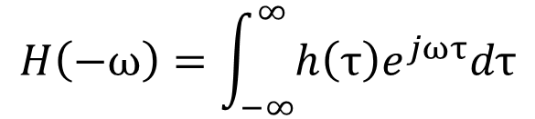
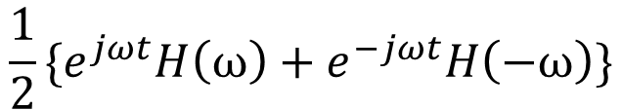
Output of an LTI system to Complex Exponentials
$\{\frac{e^{j\left(ωt\right)}+e^{−j\left(ωt\right)}}{2}$}
LTI
(h(t):Real & Stable}
$$\frac{1}{2}\{e^{jωt}H\left(ω\right)+e^{−jωt}H\left(−ω\right)\}$$
$$H\left(−ω\right)=\int_{−∞}^{∞}{h\left(τ\right)e^{jωτ}dτ}$$
$$\int_{−∞}^{∞}{\left|h\left(τ\right)\right|dτ<∞}$$
$$=\overline{\int_{−∞}^{∞}{h\left(τ\right)e^{−jωτ}dτ}}$$
$$=\overline{H(ω)}$$

Slide 44

Output of an LTI system to Complex Exponentials
$\{\frac{e^{j\left(ωt\right)}+e^{−j\left(ωt\right)}}{2}$}
LTI
(h(t):Real & Stable}
$$\frac{1}{2}\{e^{jωt}H\left(ω\right)+e^{−jωt}H\left(−ω\right)\}$$
$$H\left(−ω\right)=\overline{H(ω)}$$
$$\int_{−∞}^{∞}{\left|h\left(τ\right)\right|dτ<∞}$$
{Conjugate symmetry}

Slide 45
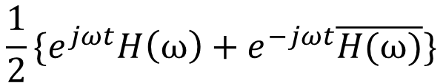
Output of an LTI system to Complex Exponentials
$\{\frac{e^{j\left(ωt\right)}+e^{−j\left(ωt\right)}}{2}$}
LTI
(h(t):Real & Stable}
$$\frac{1}{2}\{e^{jωt}H\left(ω\right)+e^{−jωt}\overline{H(ω)}\}$$
$$H\left(−ω\right)=\overline{H(ω)}$$
$$\int_{−∞}^{∞}{\left|h\left(τ\right)\right|dτ<∞}$$
{Conjugate symmetry}

Slide 46

Output of an LTI system to Complex Exponentials
$\{\frac{e^{j\left(ωt\right)}+e^{−j\left(ωt\right)}}{2}$}
LTI
(h(t):Real & Stable}
$$Re\{e^{jωt}H\left(ω\right)\}$$
$$H\left(−ω\right)=\overline{H(ω)}$$
$$\int_{−∞}^{∞}{\left|h\left(τ\right)\right|dτ<∞}$$
{Conjugate symmetry}

Slide 47

Output of an LTI system to Complex Exponentials
$\{\frac{e^{j\left(ωt\right)}+e^{−j\left(ωt\right)}}{2}$}
LTI
(h(t):Real & Stable}
$$Re\{e^{jωt}\left|H\left(ω\right)\right|e^{∠H\left(ω\right)}\}$$
$$H\left(−ω\right)=\overline{H(ω)}$$
$$\int_{−∞}^{∞}{\left|h\left(τ\right)\right|dτ<∞}$$
{Conjugate symmetry}

Slide 48

Output of an LTI system to Complex Exponentials
$\{\frac{e^{j\left(ωt\right)}+e^{−j\left(ωt\right)}}{2}$}
LTI
(h(t):Real & Stable}
$$\left|H\left(ω\right)\right|Re\{e^{jωt+∠H\left(ω\right)}\}$$
$$H\left(−ω\right)=\overline{H(ω)}$$
$$\int_{−∞}^{∞}{\left|h\left(τ\right)\right|dτ<∞}$$
{Conjugate symmetry}

Slide 49


Output of an LTI system to Complex Exponentials
LTI
(h(t):Real & Stable}
$$cosωt$$
$$\left|H\left(ω\right)\right|cos⁡(ωt+∠H\left(ω\right))$$
$$H\left(−ω\right)=\overline{H(ω)}$$
$$\int_{−∞}^{∞}{\left|h\left(τ\right)\right|dτ<∞}$$
{Conjugate symmetry}

Slide 50

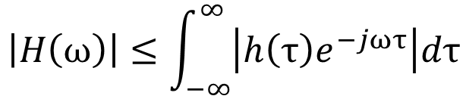
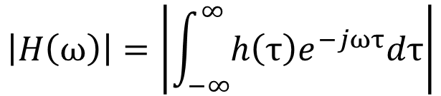
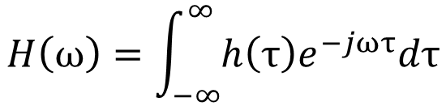
Bounds on $H\left(ω\right)$
When is $H\left(ω\right)$ guaranteed to be bounded?
$$H\left(ω\right)=\int_{−∞}^{∞}{h\left(τ\right)e^{−jωτ}dτ}$$
$$\left|H\left(ω\right)\right|=\left|\int_{−∞}^{∞}{h\left(τ\right)e^{−jωτ}dτ}\right|$$
$$\left|H\left(ω\right)\right|≤\int_{−∞}^{∞}{\left|h\left(τ\right)e^{−jωτ}\right|dτ}$$
Schwartz inequality

Slide 51
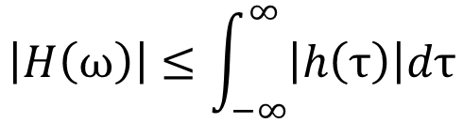
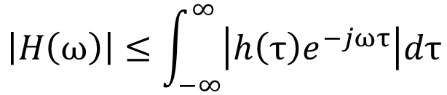
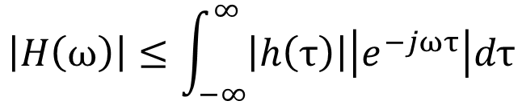
Bounds on $H\left(ω\right)$
When is $H\left(ω\right)$ guaranteed to be bounded?
$$\left|H\left(ω\right)\right|≤\int_{−∞}^{∞}{\left|h\left(τ\right)e^{−jωτ}\right|dτ}$$
Schwartz inequality
$$\left|H\left(ω\right)\right|≤\int_{−∞}^{∞}{\left|h\left(τ\right)\right|\left|e^{−jωτ}\right|dτ}$$
$$\left|H\left(ω\right)\right|≤\int_{−∞}^{∞}{\left|h\left(τ\right)\right|dτ}$$

Slide 52

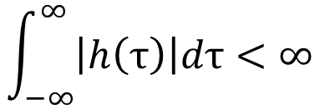
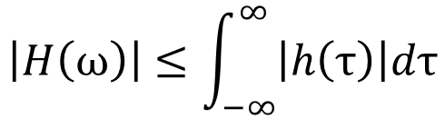
Bounds on $H\left(ω\right)$
When is $H\left(ω\right)$ guaranteed to be bounded?
$$\left|H\left(ω\right)\right|≤\int_{−∞}^{∞}{\left|h\left(τ\right)\right|dτ}$$
If system is stable,
$$\int_{−∞}^{∞}{\left|h\left(τ\right)\right|dτ<∞}$$
Thus for a stable system
$$\left|H\left(ω\right)\right|<∞$$

Slide 53
Bounds on $H\left(ω\right)$
Is stability a necessary condition for $H\left(ω\right)$ to be bounded?
No !!.

Slide 54
Outline of the lecture
Why sinusoids?
How an LTI system react to sinusoids?
How do we break signal as sums of sinusoids?

Slide 55
Towards Fourier Series

Slide 56
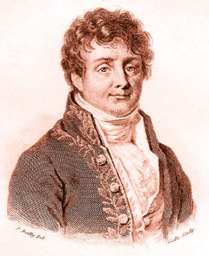
Jean Baptiste Joseph Fourier

Slide 57
Brief Biography
Jean-Baptiste Joseph Fourier (21 March 1768 – 16 May 1830) was a French mathematician and physicist born in Auxerre.
He lived during the time of French revolution and even escaped guillotine.
Fouier was an Egyptologist and accompanied Napolean Bonaparte on his Egyptian expedition.
He is buried in the Père Lachaise Cemetery in Paris.
His name is one of the 72 names inscribed on the Eiffel Tower.
Worked at École Polytechnique.
He is best known for Fourier series. Fourier Series is described by many as the most beautiful mathematical poem.

Slide 58
Criticized heavily
S. F. Lacroix
G. Monge
P. S. De Laplace
J. L. Lagrange
Further reviewed by Poisson
and Legendre

Slide 59
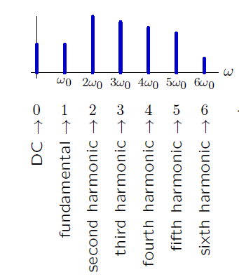
Harmonics

